Slide 1
3- Types of Functions

Slide 2
in programming we have two types of functions:
perform a task
calculate and return a value

Slide 3
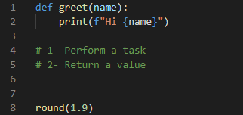
print and greet functions
Type one: perform a task
which is printing something on the terminal.
round function
calculates and returns a value

Slide 4
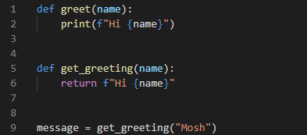
we use the return statement to return a value from this function.
because it returns a value we can store that value in a separate variable like message

Slide 5
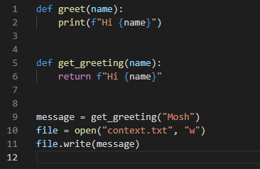
which form of these greeting functions is better?
first implementation:
we are locked to printing something in the terminal.
In the future if you want to write that message in a file or send it in an email you have to create another function so we cannot reuse this greet function in other scenarios
second form:
is not tied to printing something under terminal. It simply returns a value. Now we get this value and we can do whatever we want with it
Print it on the terminal
Write it to a file
Send it in an email
…

Slide 6
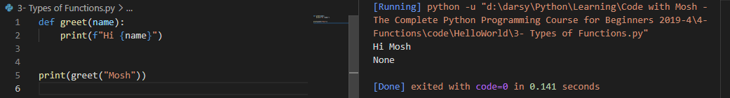
None is the return value of the greet function
in Python all functions by default return the None value. unless you specifically return a value
None is an object that represents the absence of a value.
So even though this function returns none by default, It is still classified as a function that carries out a task

